Slide 1







CareGiving
se
DailyD
O
Daily Dose - Small reminders, Big impact
Get Started
Notes:
Good morning, respected panel and everyone.
Today, we unveil DailyDose, a beacon of care in the digital age. Our tagline, "Small Reminders, Big Impact," encapsulates our mission to make a profound difference in the lives of our seniors through a simple yet powerful tool.
DailyDose is designed to help our seniors take their medicine on time without missing doses, and enable caretakers to monitor and assist them effectively.

Slide 2


DailyDose
About Us
DailyDose blends reminders and medical recommendations to personalize routine healthcare for Seniors based on users input meds, goals, and habits.
Your Trusted Healthcare Companion
Notes:
Imagine a world where forgetting to take medication or drinking water is no longer a concern.
DailyDose empowers the elderly to lead healthier lives with timely reminders and a progress bar that celebrates every small victory.

Slide 3


DailyDose
Our Outcomes
1.
Track reminders
Daily Dose empowers users to manage health on the go.
Tracks progress
2.
Offers insights
3.
Notes:
DailyDose isn't just an app; it's a vital resource for those who cherish independence but need a nudge with their daily tasks. Our motto, 'Track progress and offer insights,' reflects our commitment to unwavering support for the elderly community.

Slide 4
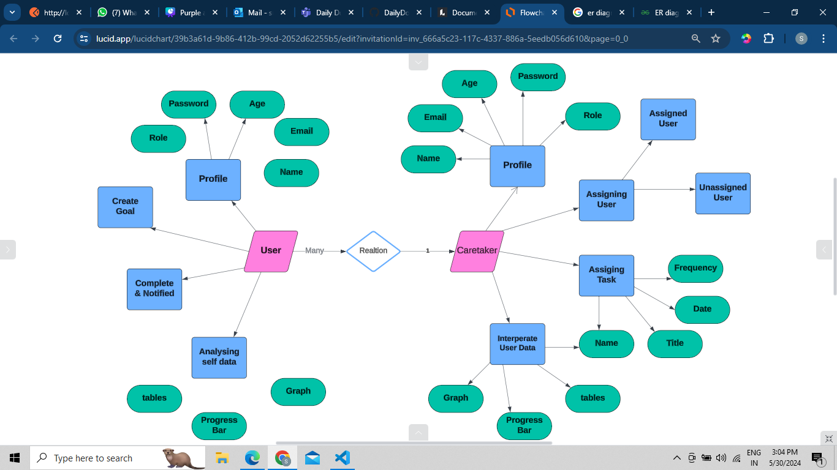
Work Flow [ ER Diagram]
4
Notes:
The heart of DailyDose lies in its meticulously crafted workflow. Our ER diagram is more than just a technical blueprint;
It narrates the story of connections and care. From 'User' to 'Task,' each entity stands as a testament to our commitment to user-centric design.

Slide 5
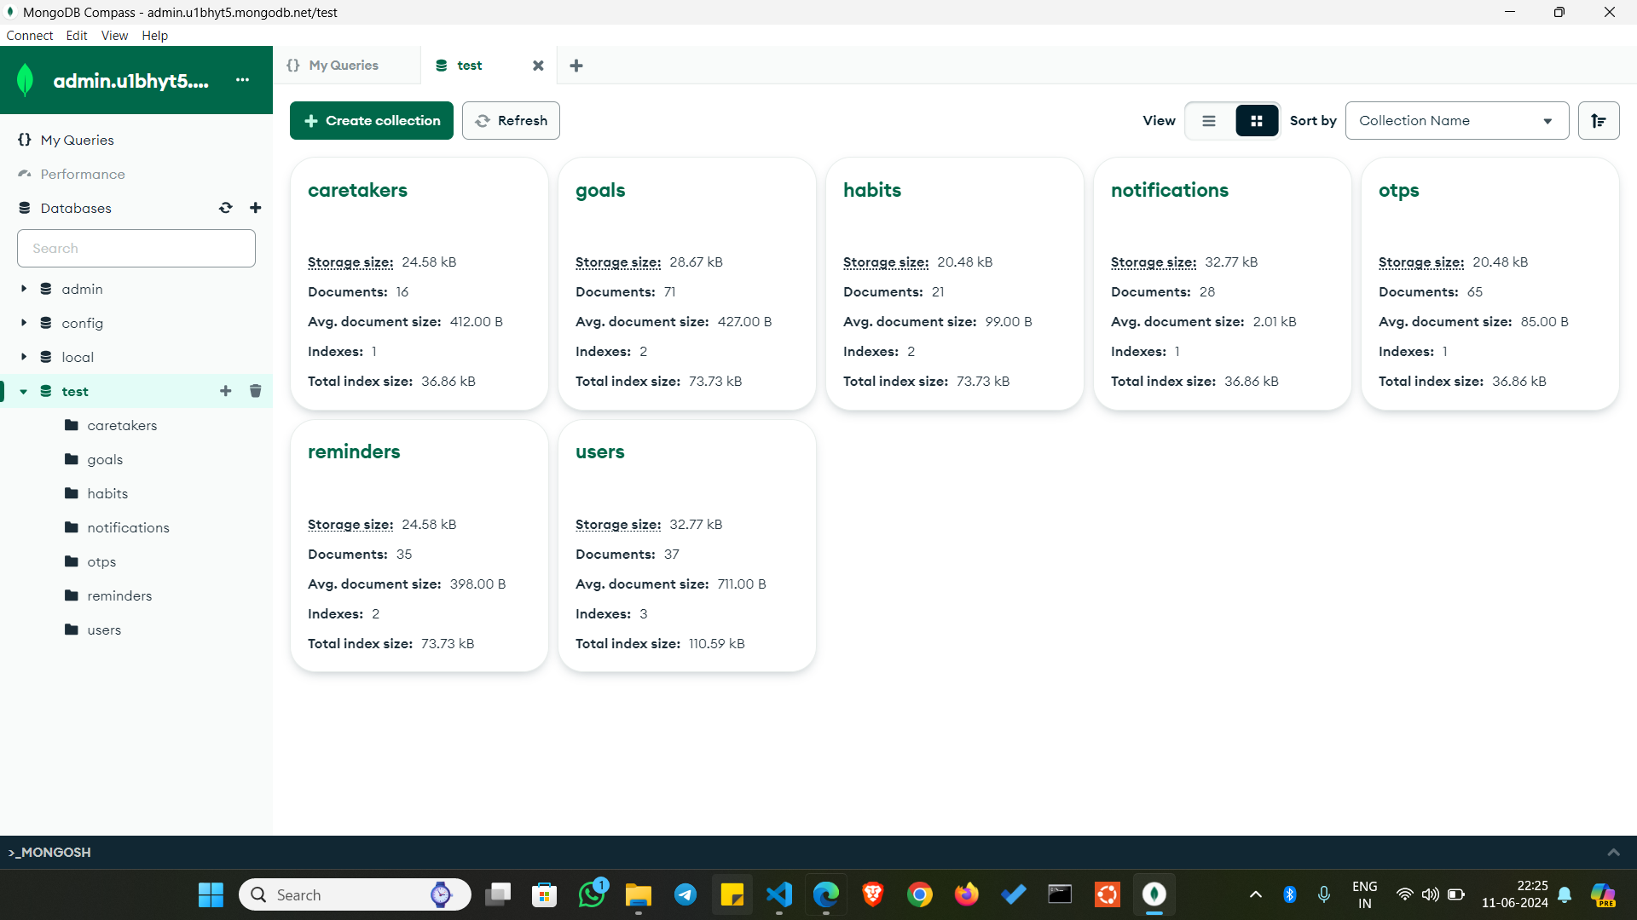
Database
4
Notes:
The heart of DailyDose lies in its meticulously crafted workflow. Our ER diagram is more than just a technical blueprint;
It narrates the story of connections and care. From 'User' to 'Task,' each entity stands as a testament to our commitment to user-centric design.

Slide 6
Our Website
4
Notes:
Let’s dive and discover all the cool features our web app has to offer!

Slide 7
DailyDose
Let’s
Dive deep and discover all the cool features of our web app has to offer!

Slide 8
Register as a User
4
Notes:
Indulge in the full experience of our app by registering and unlocking all its features

Slide 9
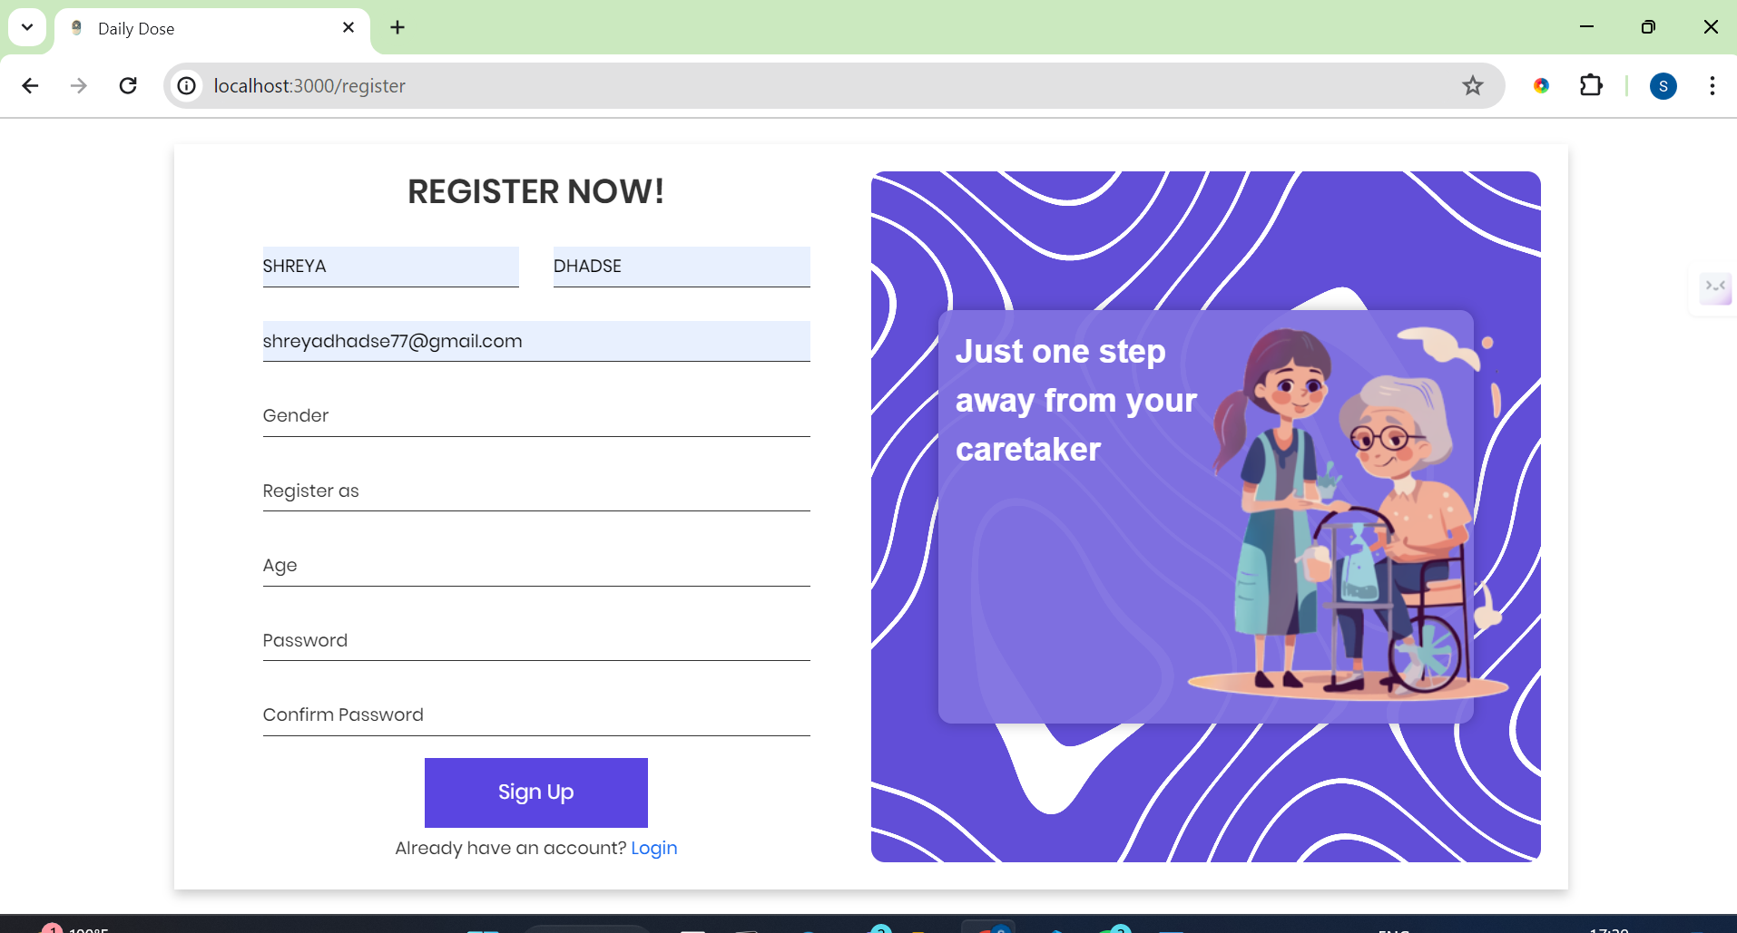
Registration Page
Notes:
This is our registration page which is designed with simplicity and inclusivity in mind, ensuring that everyone, whether you're a user or a caretaker, can easily create an account and start your journey with us.

Slide 10
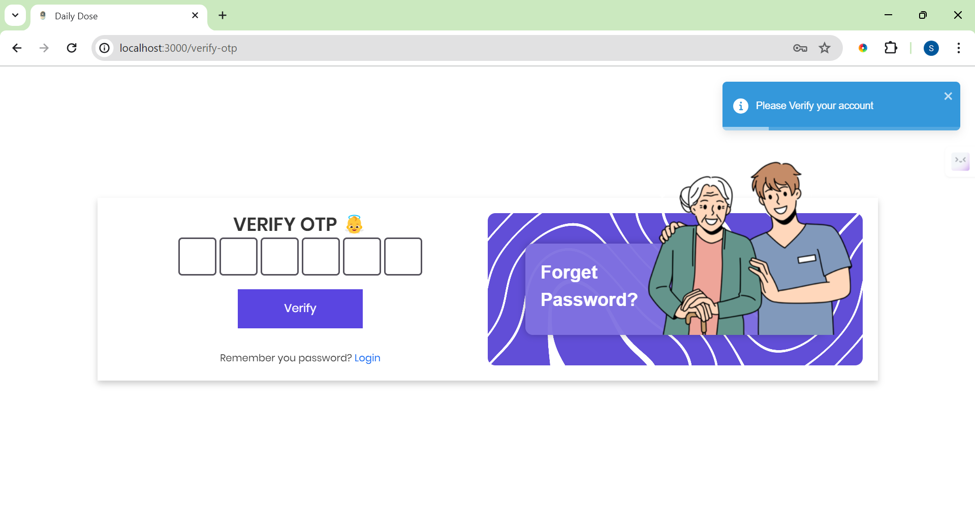
Verification for registeration
Notes:
So before proceeding, you must verify your account with an OTP we have send you to the registered email address.

Slide 11
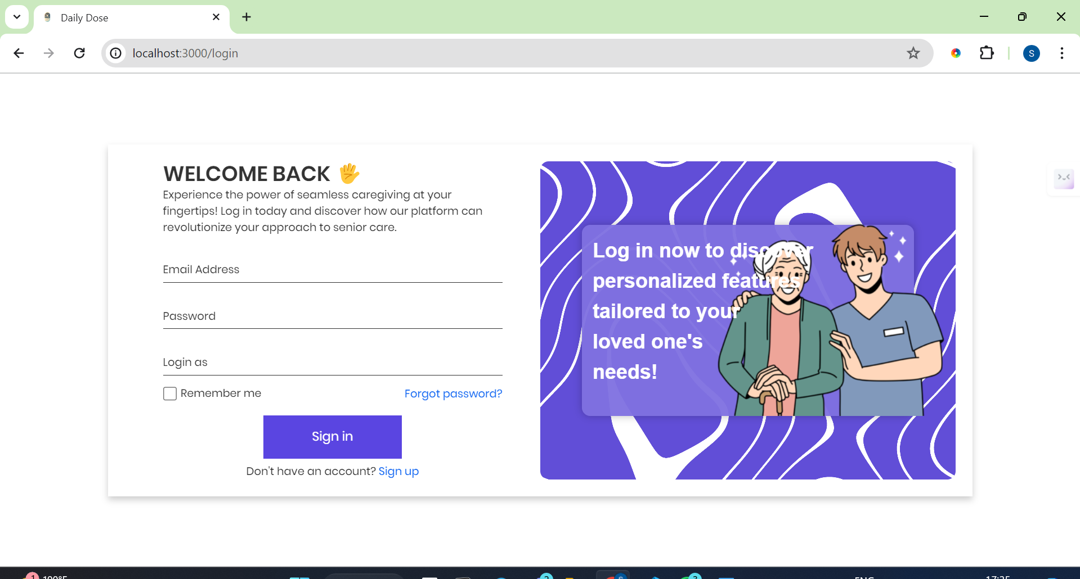
Login Page
Notes:
Welcome to the gateway of our web application, DailyDose. This is where the journey to better health management begins.

Slide 12
DailyDose
Login Page
This page serves as both the gateway and the welcoming interface to our web application.

Slide 13
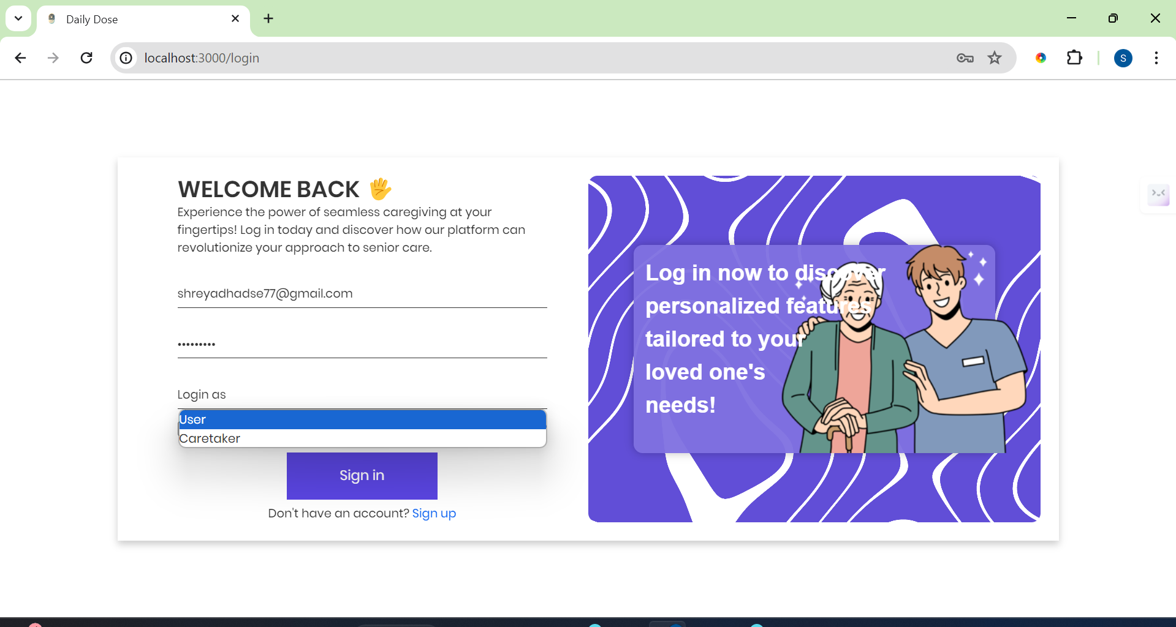

User or Caretaker
Notes:
Our login page is thoughtfully designed to cater, role based users: the individuals using our service (seniors) is user,
and the caretakers who support them.

Slide 14
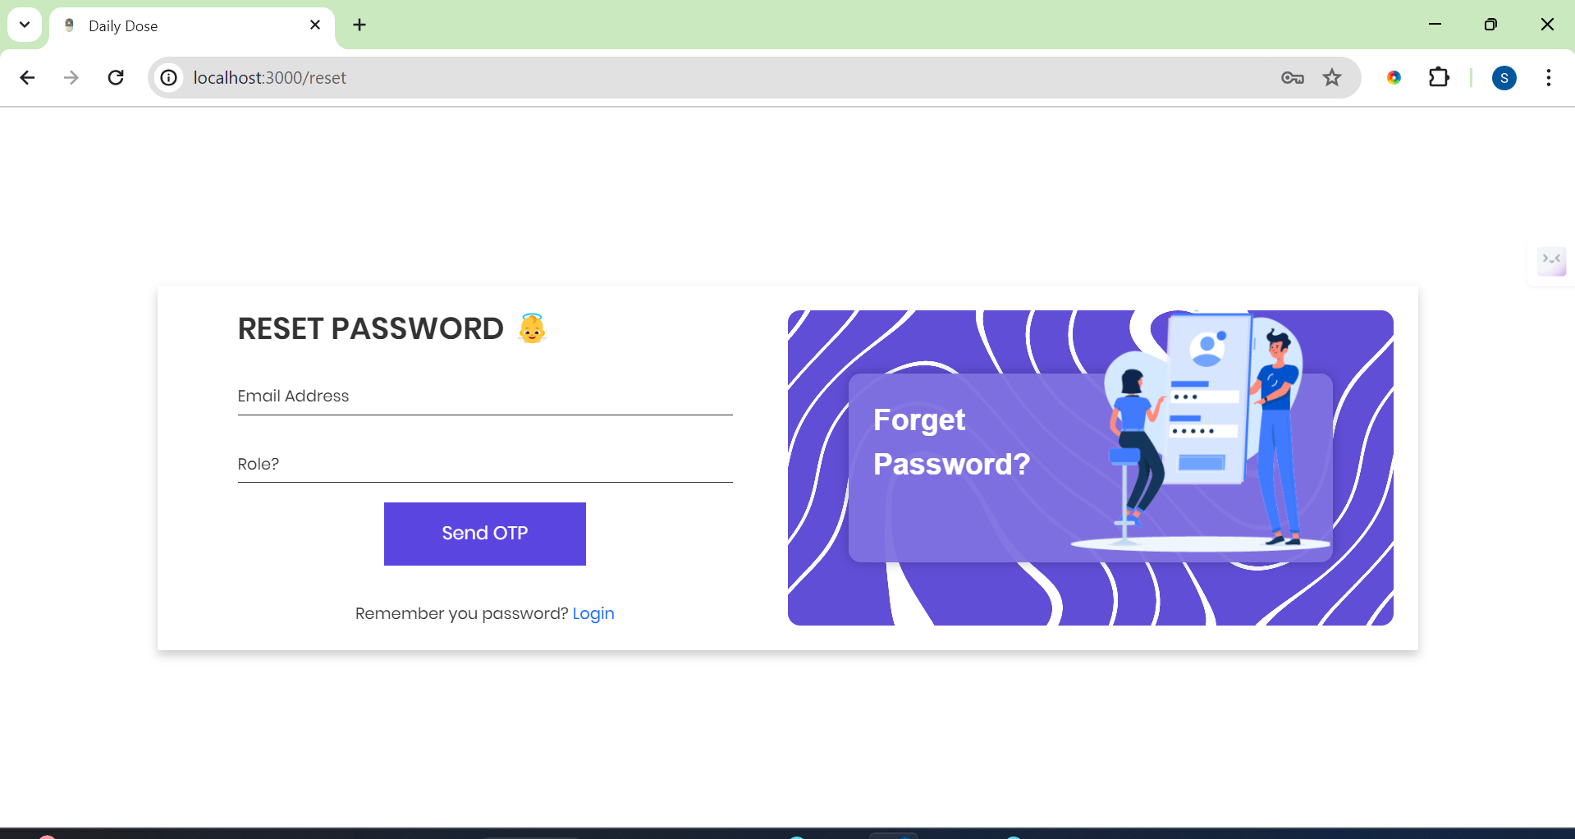
Forget Password Page
Notes:
Nowadays, forgetting password is very common and specially when our users belong to the elderly age group.
This is why our reset password page is designed to help you quickly regain access to your account while maintaining the high security standards.

Slide 15
User Dashboard
4
Notes:
So after successfully logging in or registering, user will be redirected to their dashboard.

Slide 16
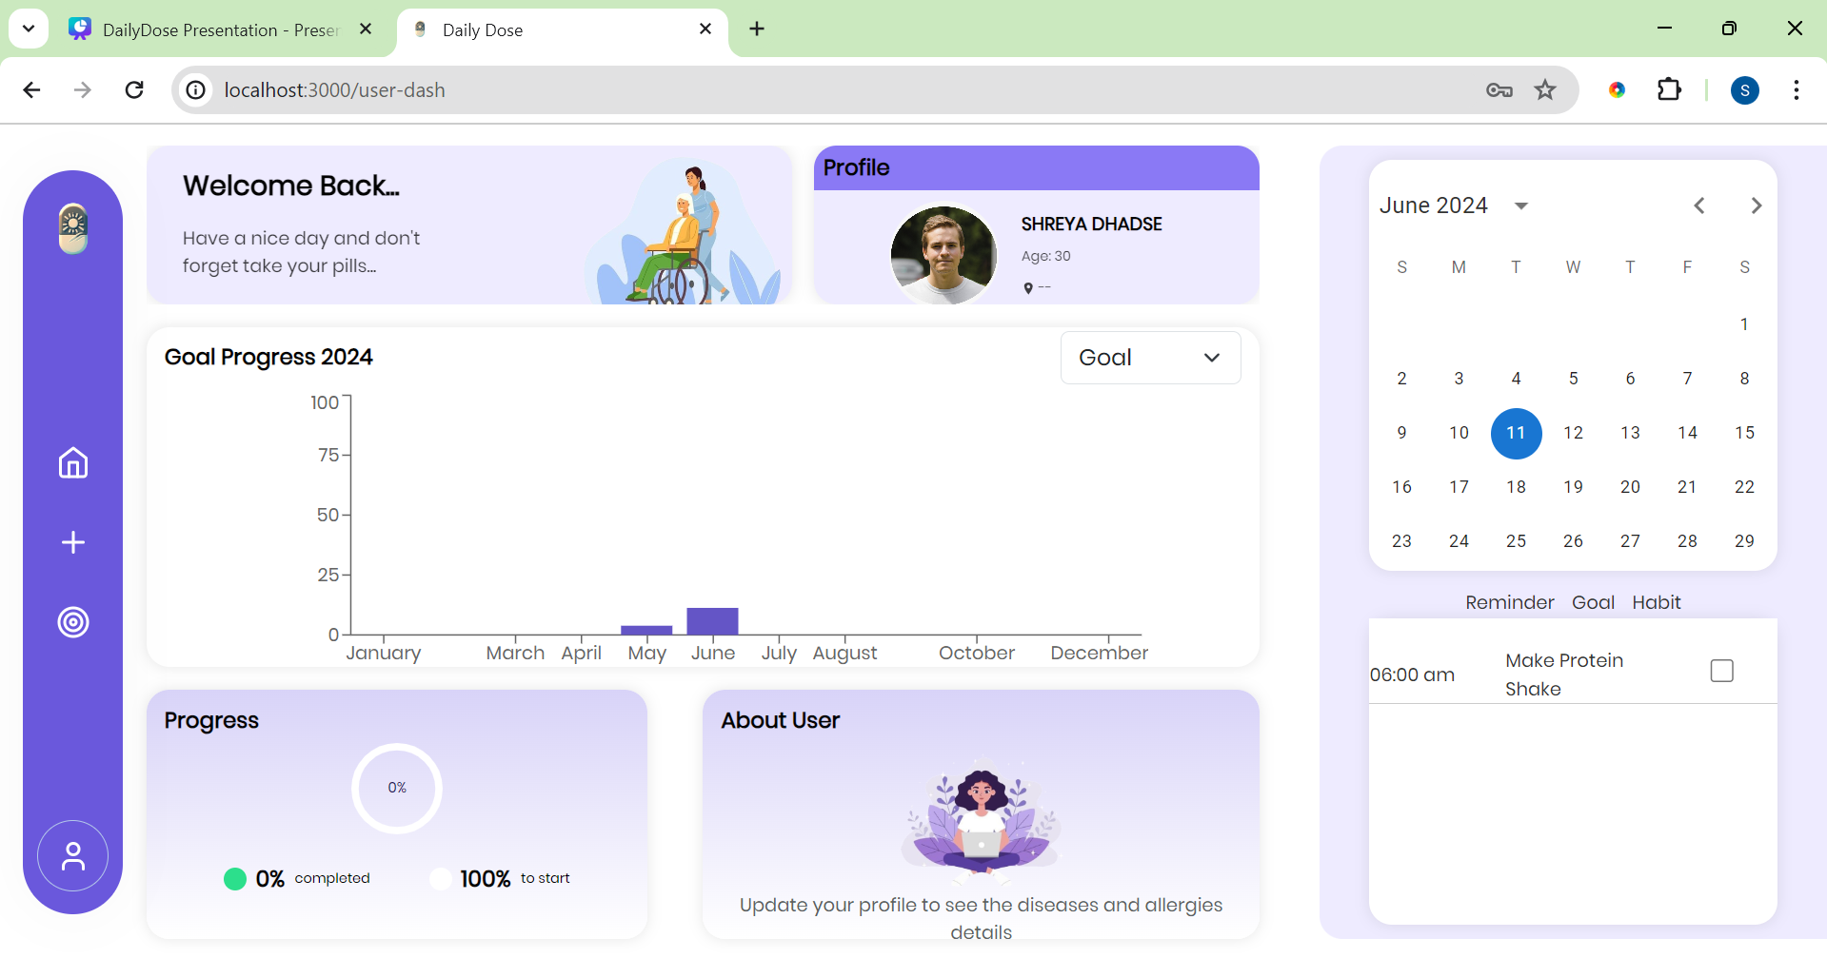
User Dashboard
Notes:
Here you're greeted by a warm welcome card. It's our way of saying 'Hello' and reminding you that your journey to better health and well-being is important to us.

Slide 17
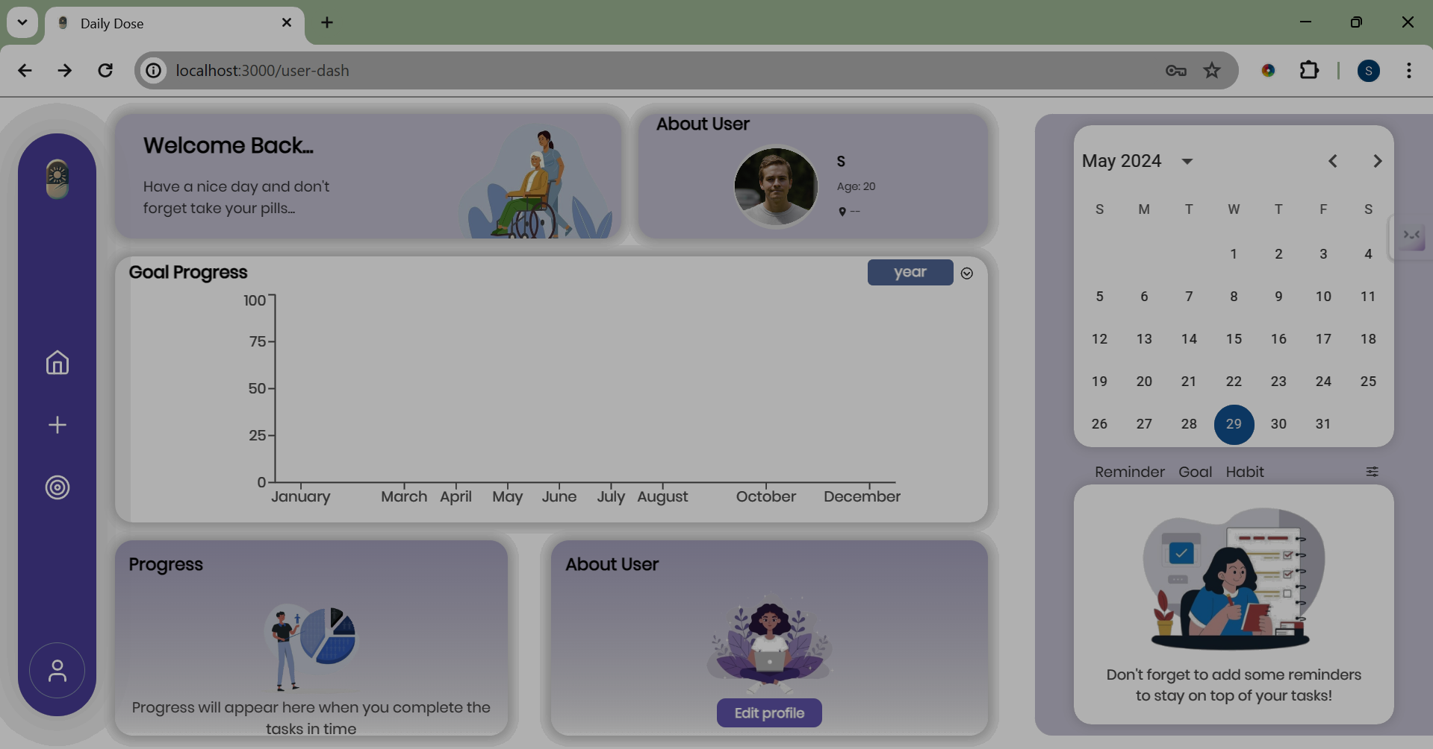


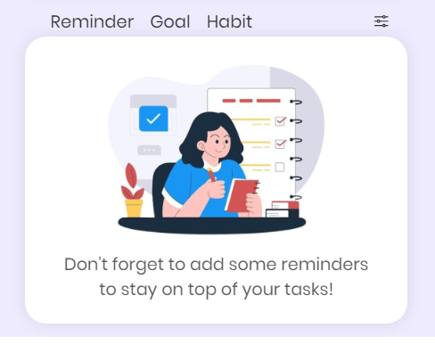
User Dashboard
Added reminders,goals & habits appear here
Notes:
Explore your goals, reminders, and habits effortlessly with our convenient panel nestled in the bottom-right corner, allowing you to navigate through each aspect seamlessly.

Slide 18
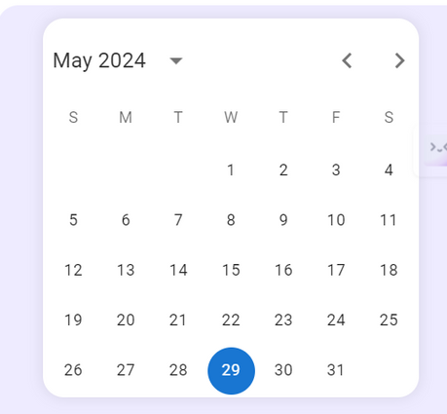
User Dashboard
Task Calender
Notes:
Our task calendar provides a nice and efficient overview of your tasks organized by date, giving you a quick glance.

Slide 19
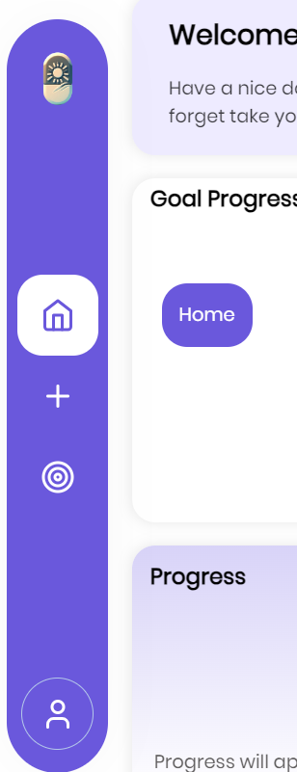
User Dashboard
To navigate back to home

Slide 20
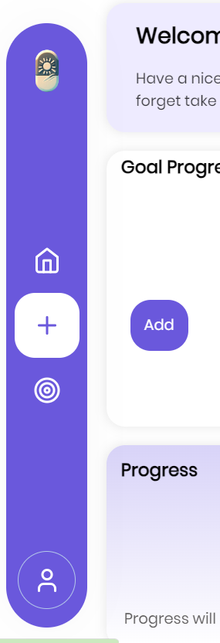
User Dashboard
Navigate to add goal,habit & reminder

Slide 21
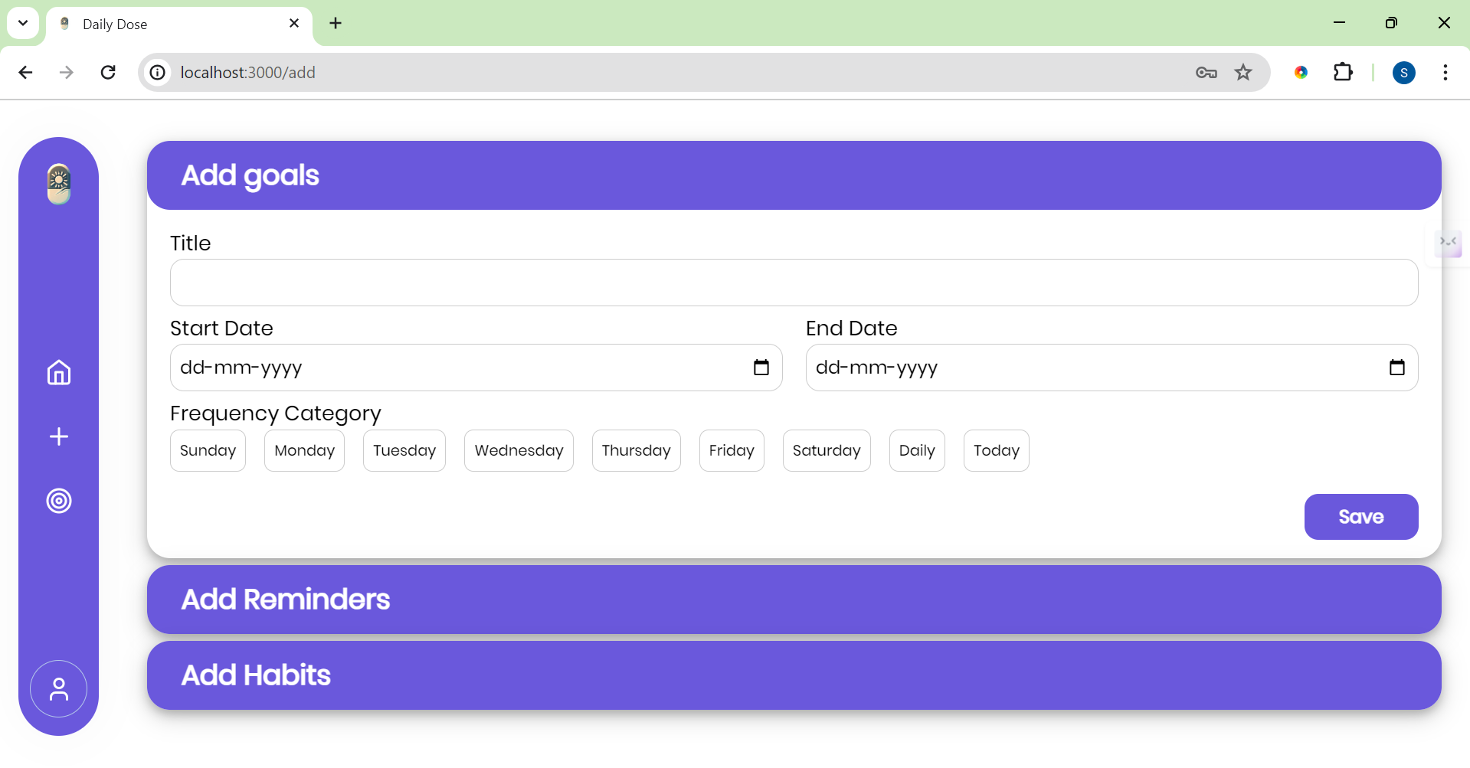
Add Goals

Slide 22
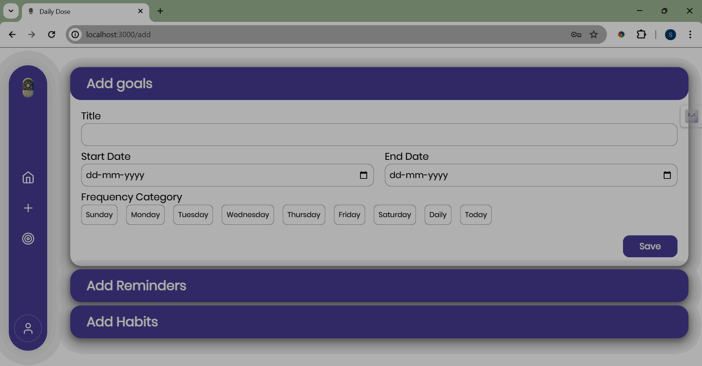
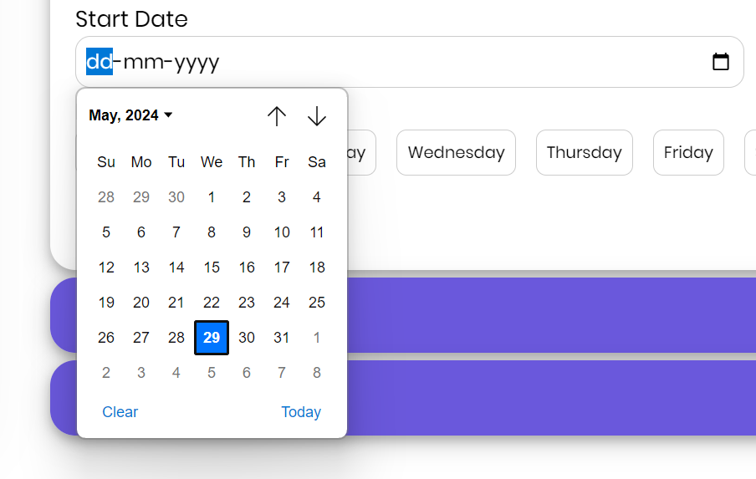
Add Goals
Set start date for goal

Slide 23
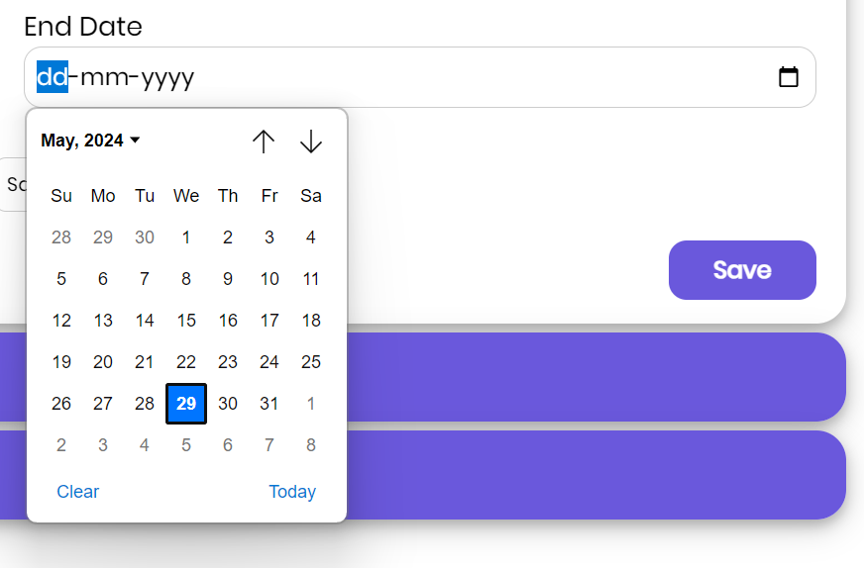
Add Goals
Set accomplish date for goal

Slide 24
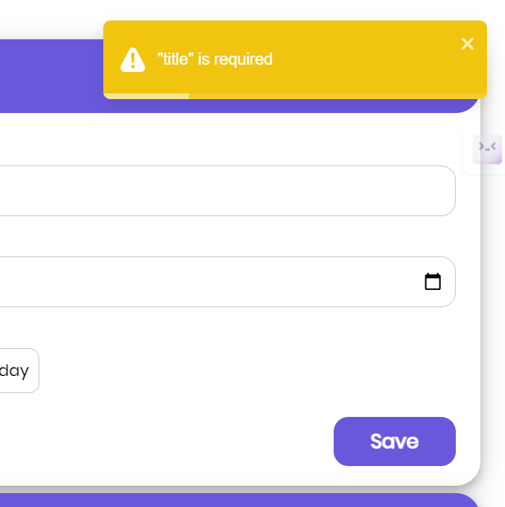
Warnings
Dialog box to guide user

Slide 25
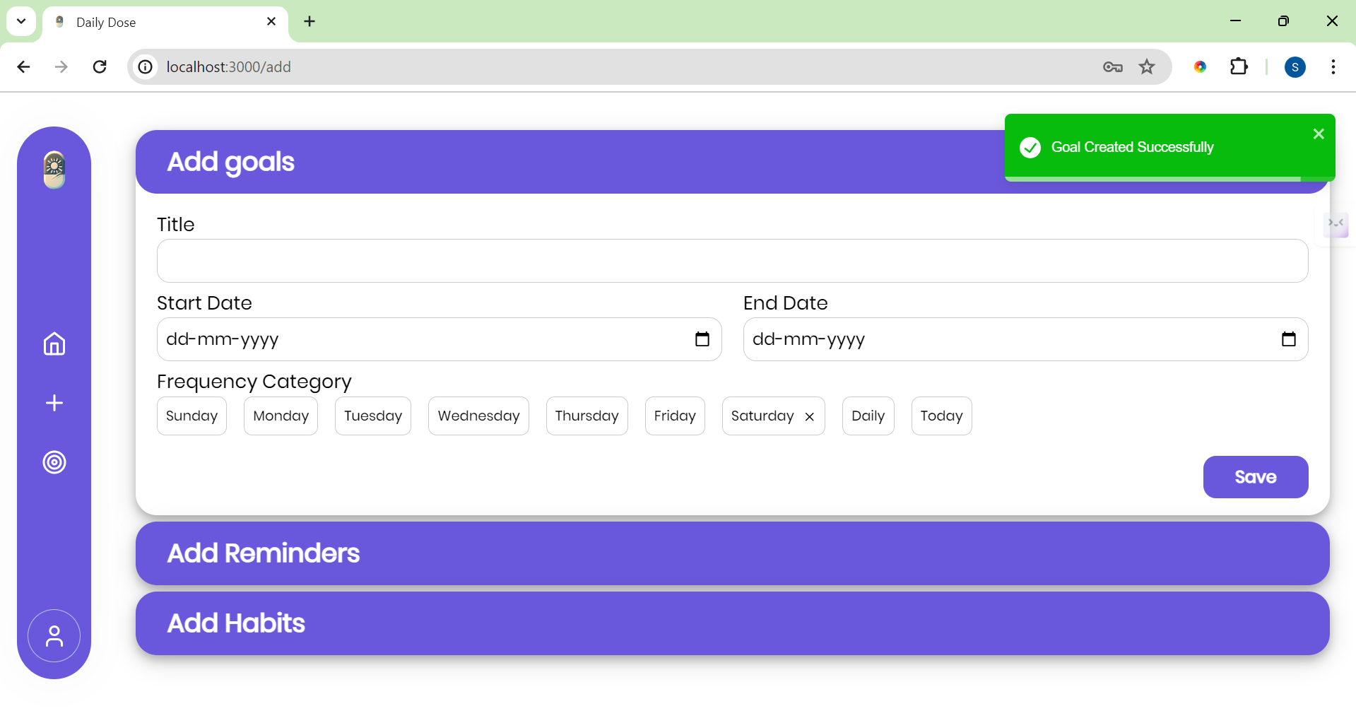
Goal Added Successfully
User gets informed about their actions

Slide 26
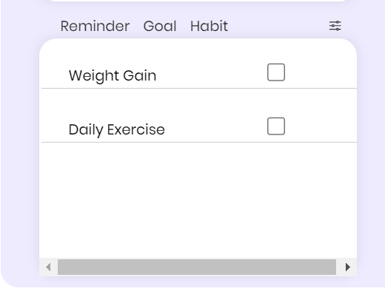
User Dashboard
Goals , when added

Slide 27
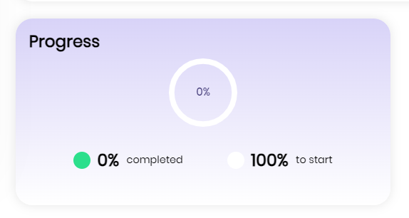
User Dashboard
Progress bar

Slide 28
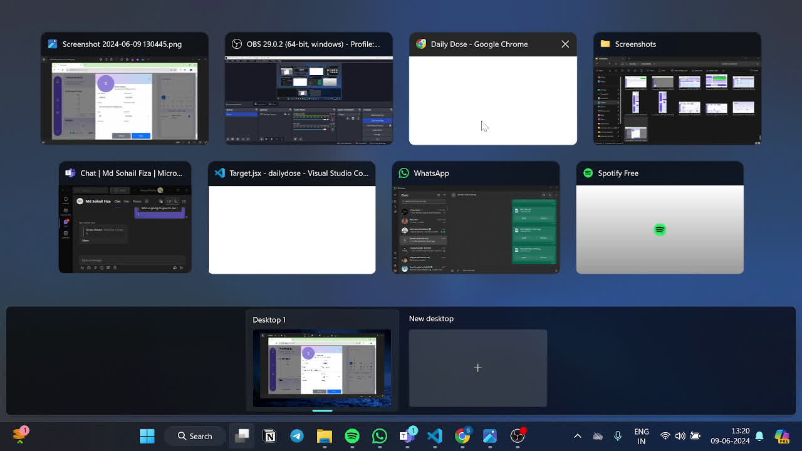
Progress Profile Card on Updating Goals

Slide 29
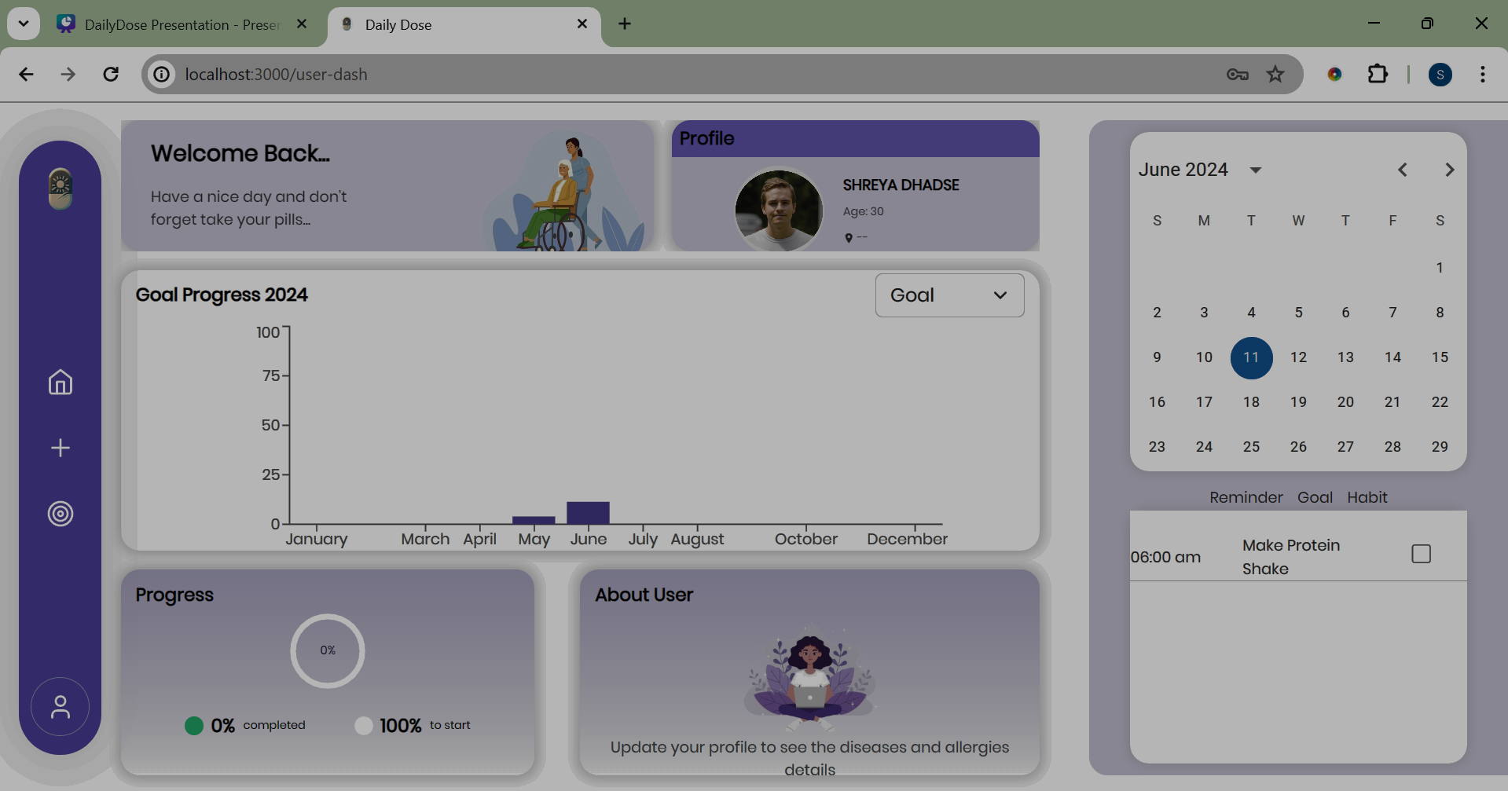
Goal Progress
Yearly Progress

Slide 30
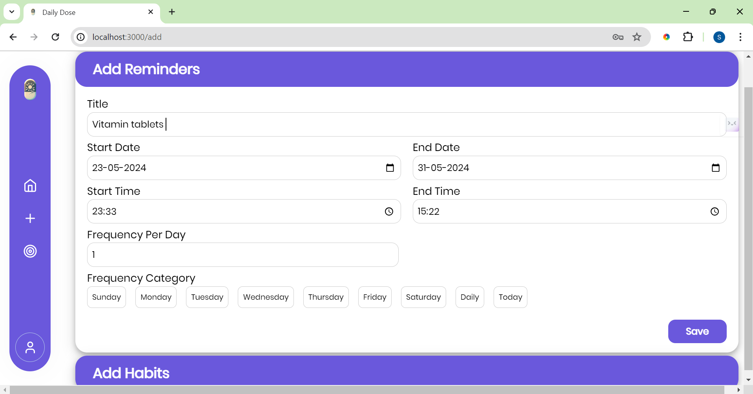
Add Reminders

Slide 31
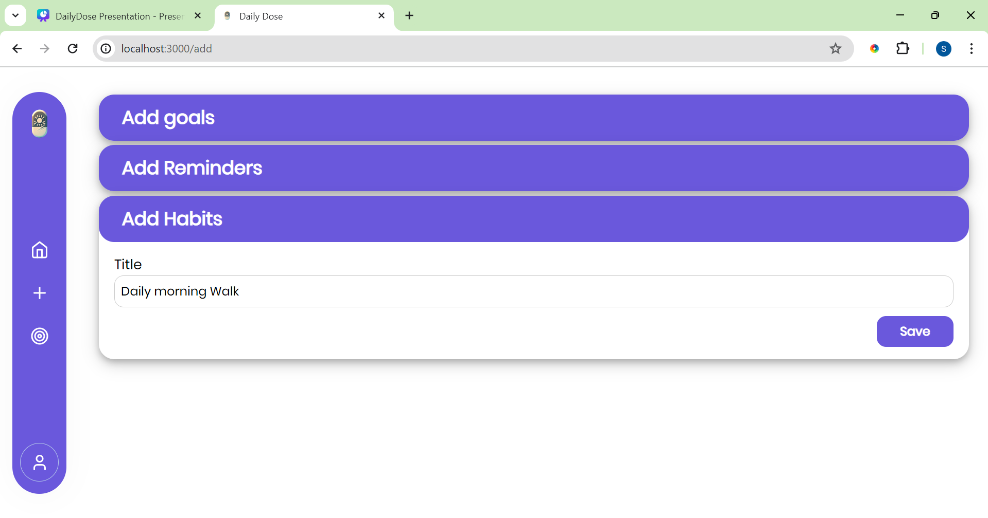
Add Habits

Slide 32
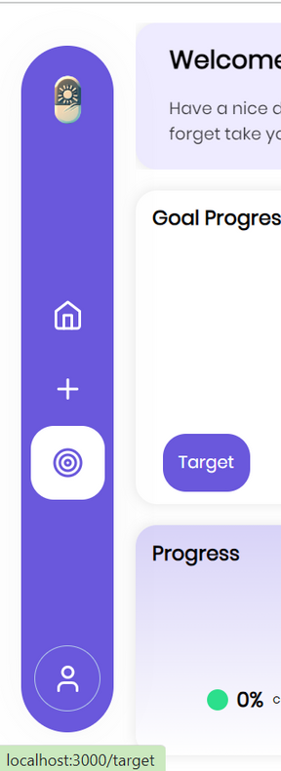
User Dashboard
Navigate to look at targets

Slide 33
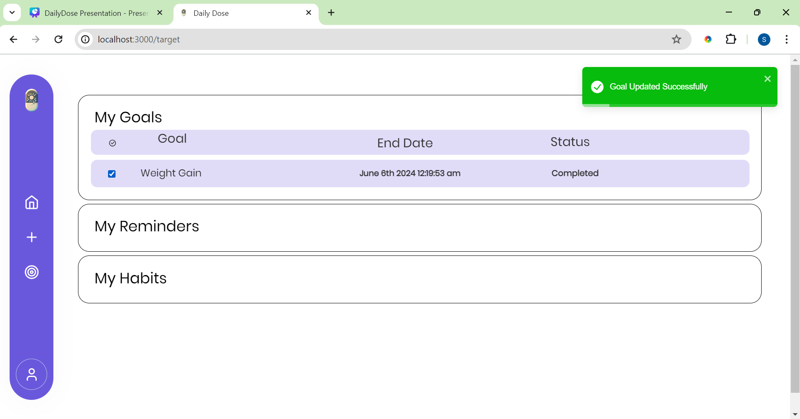
Check the Targets

Slide 34
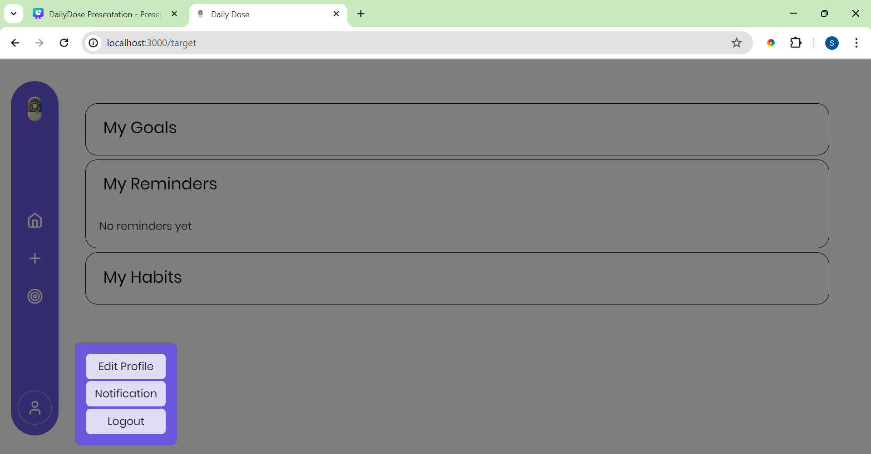
Navigation
Profile Settings

Slide 35
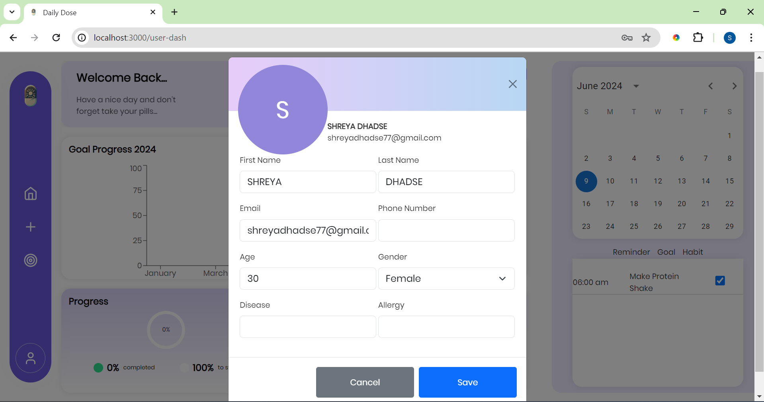
Edit Profile
To Edit Profile

Slide 36
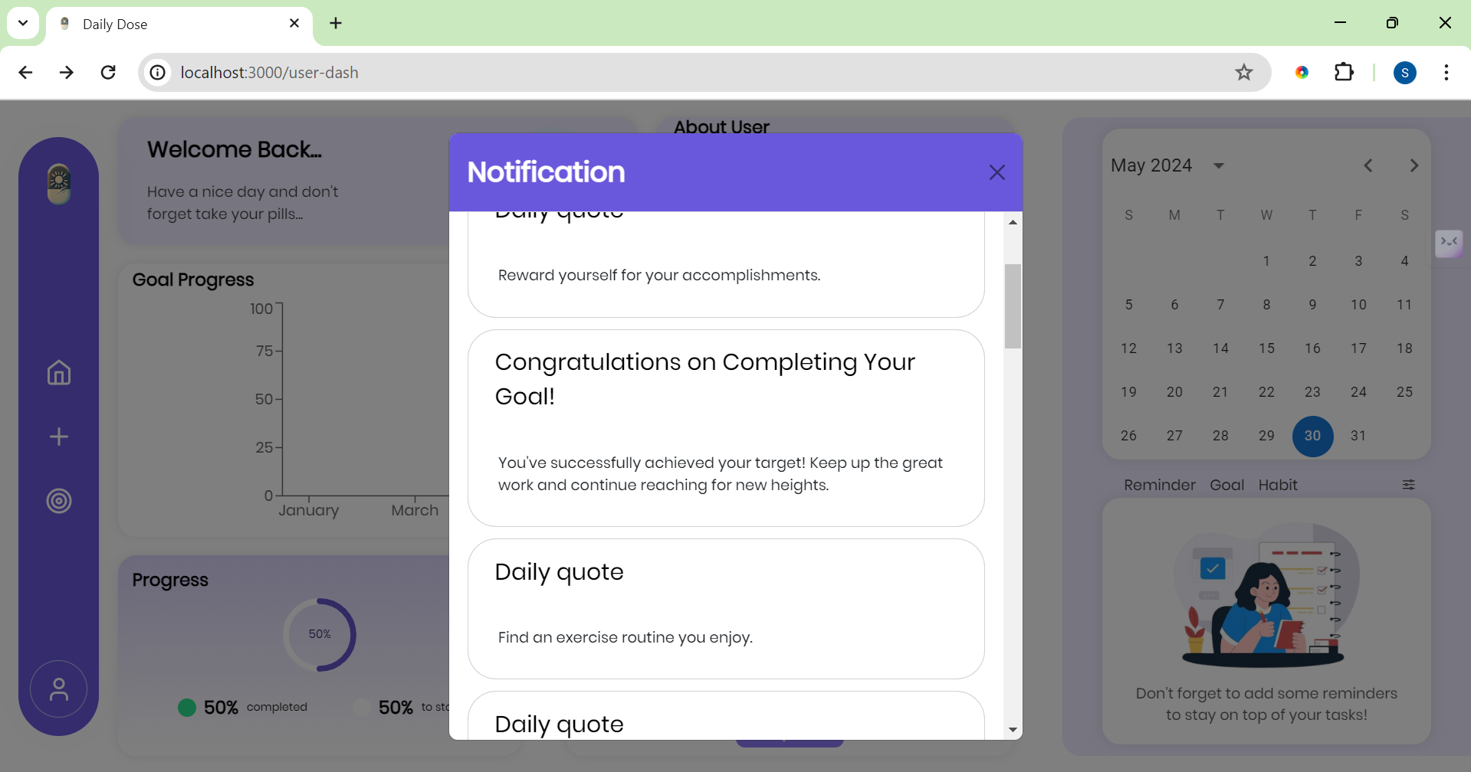
Notifications

Slide 37
Registered as a Caretaker
4

Slide 38
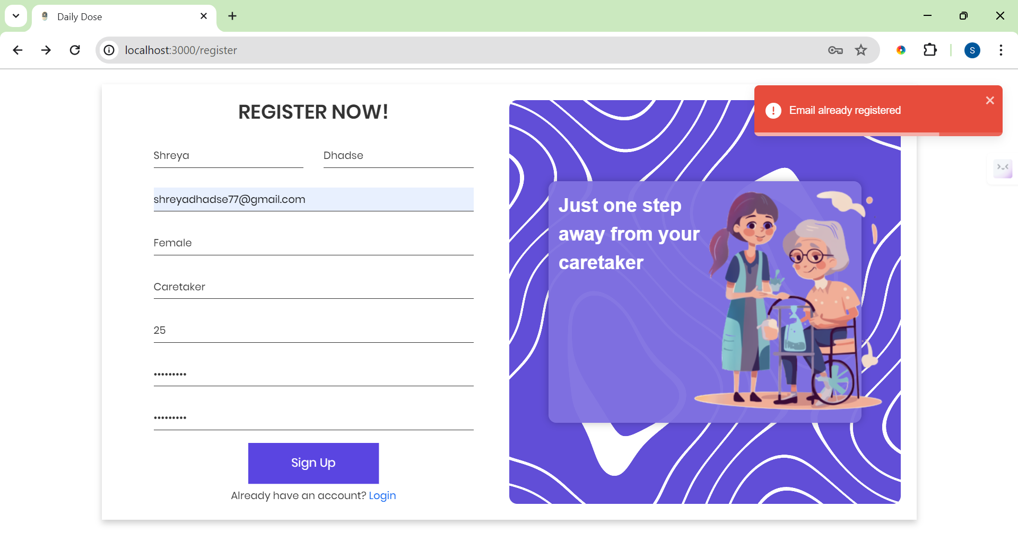
Login Page

Slide 39
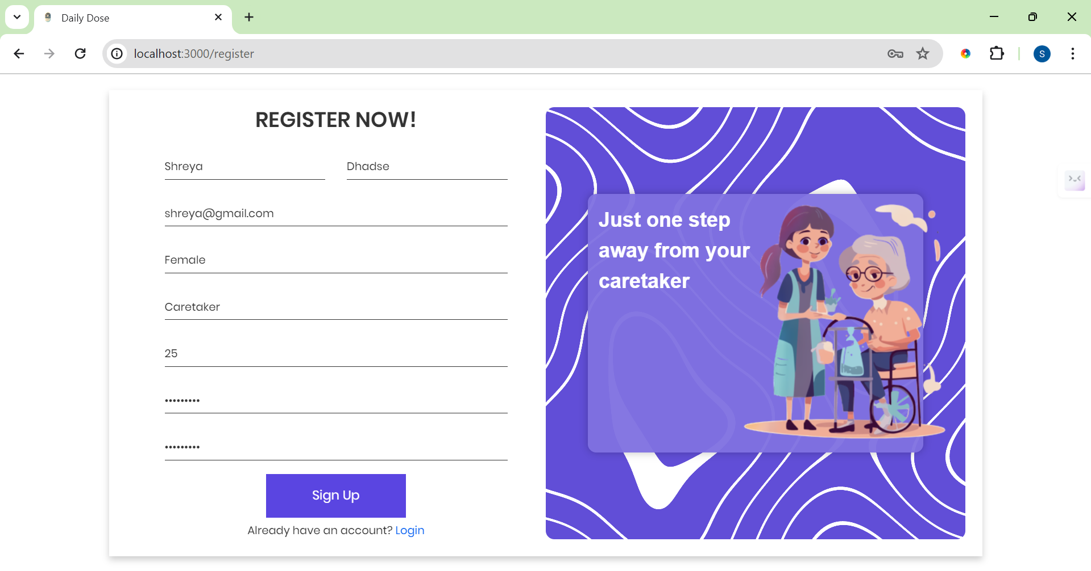
Login Page

Slide 40
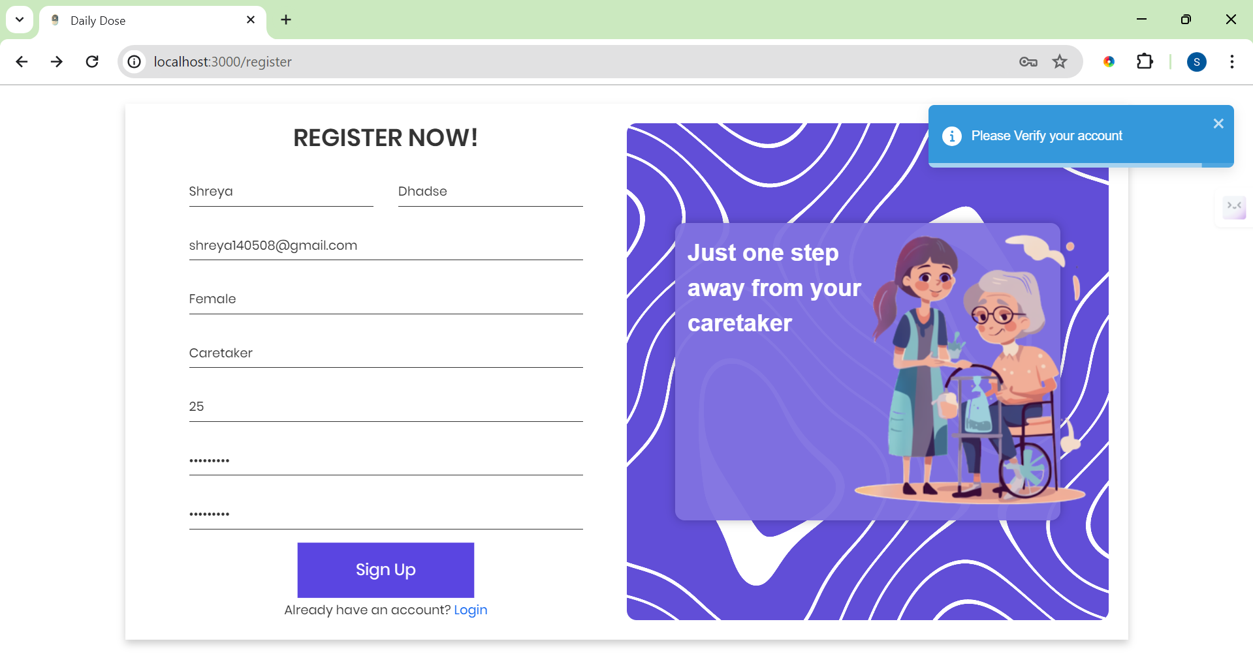
Login Page

Slide 41
Verification for registeration

Slide 42
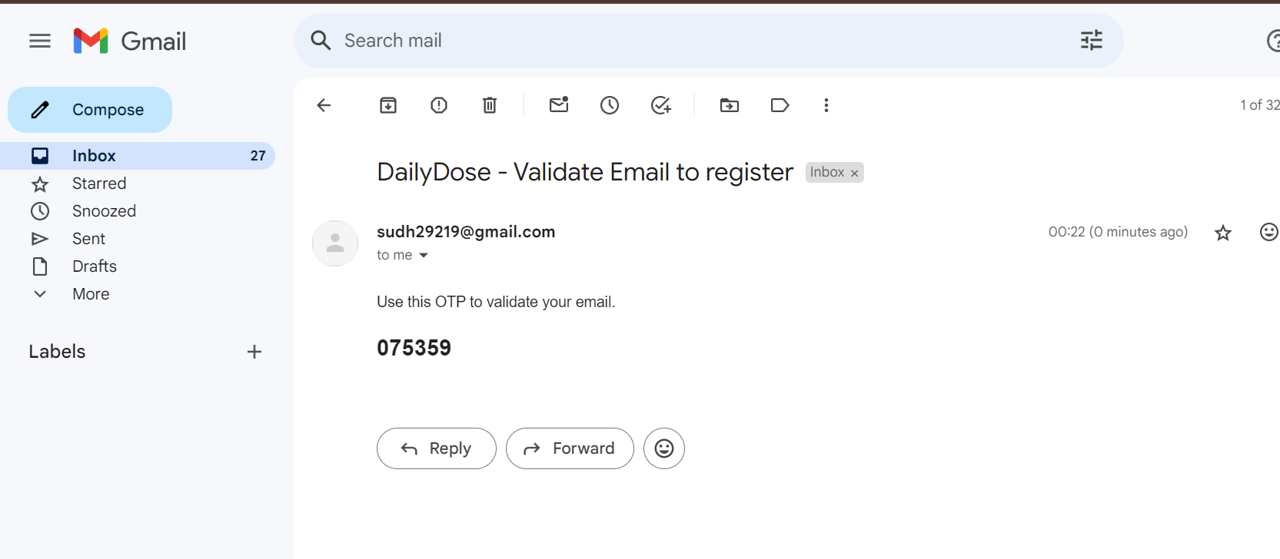
Verification for registeration
OTP- One Time Password

Slide 43
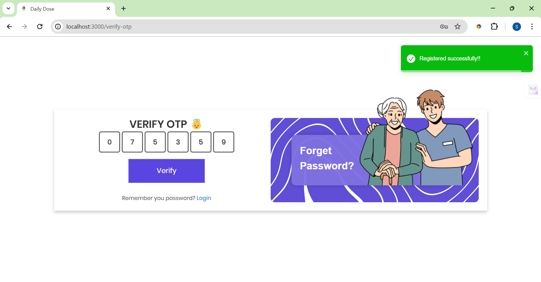
Verification for registeration

Slide 44
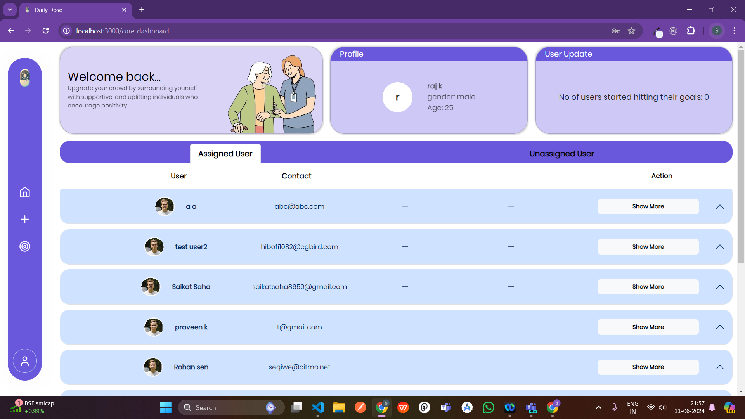
Caretaker Dashboard

Slide 45
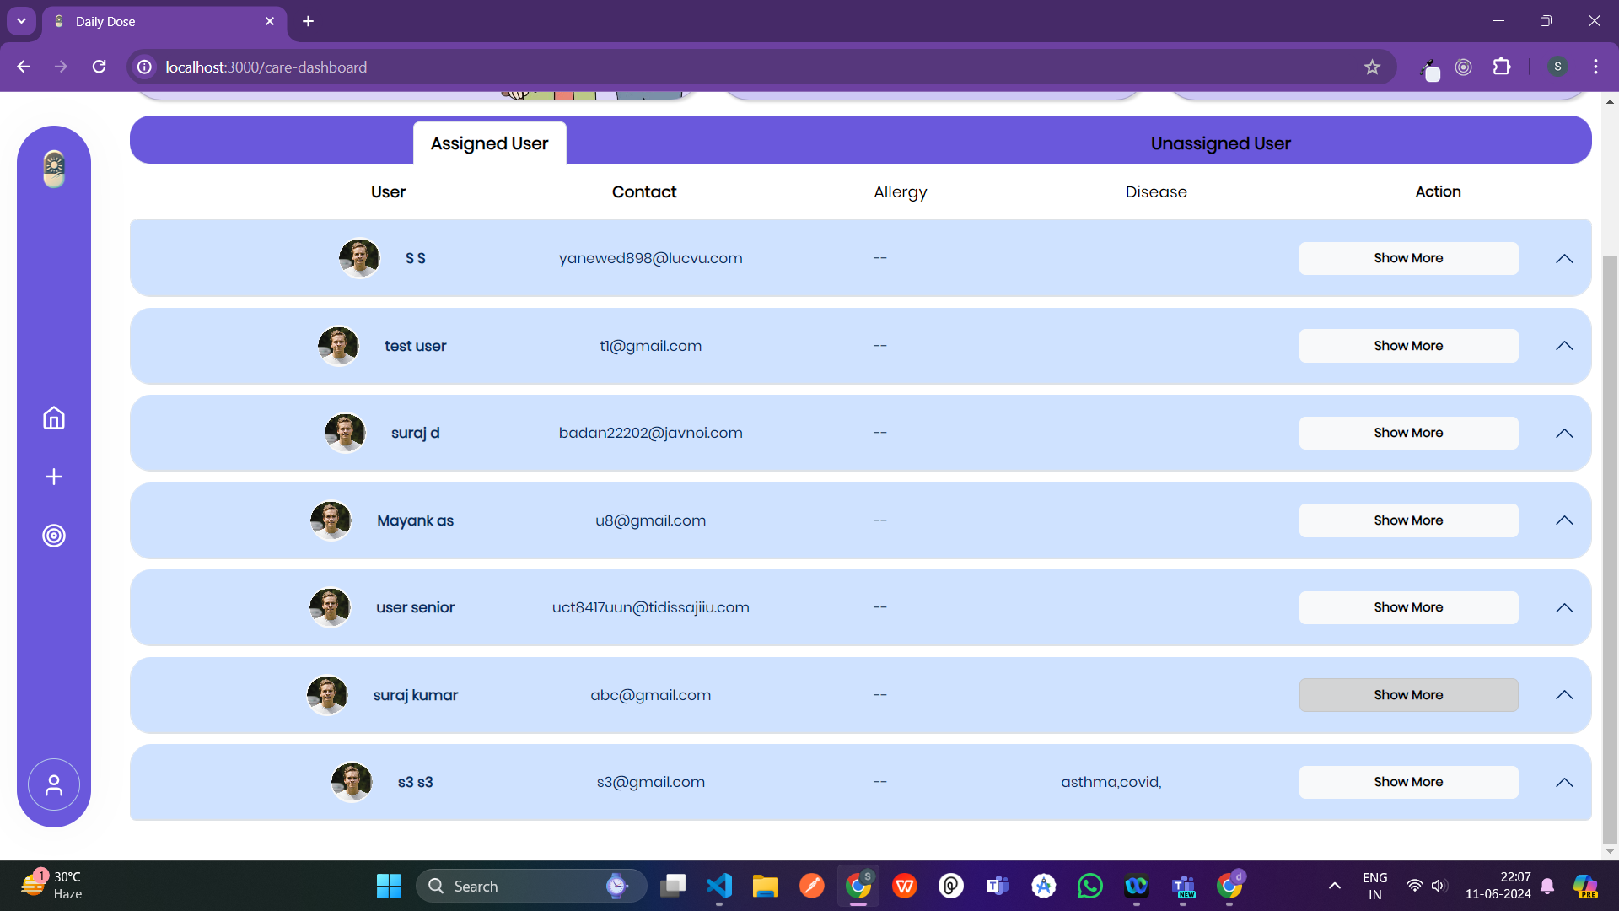
Caretaker Dashboard

Slide 46
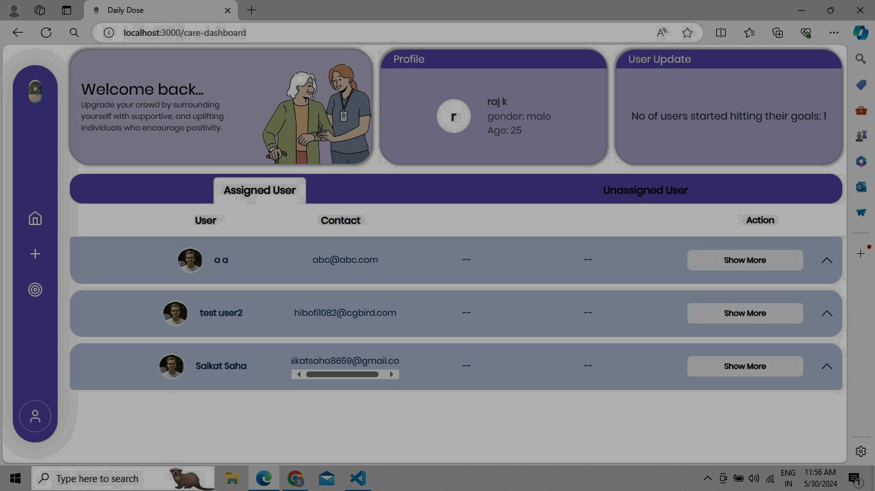
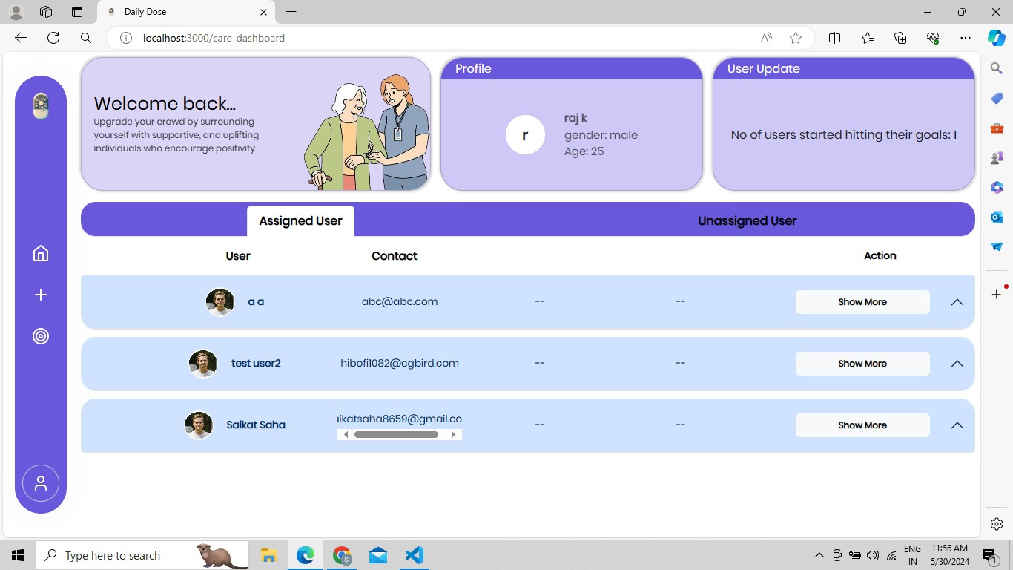
Caretaker Dashboard
Assigned users

Slide 47
Caretaker Dashboard
Know more about user

Slide 48
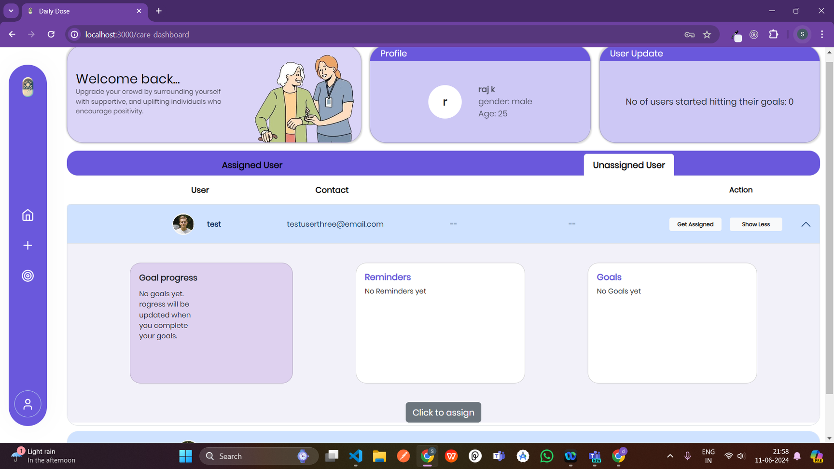
Caretaker Dashboard

Slide 49
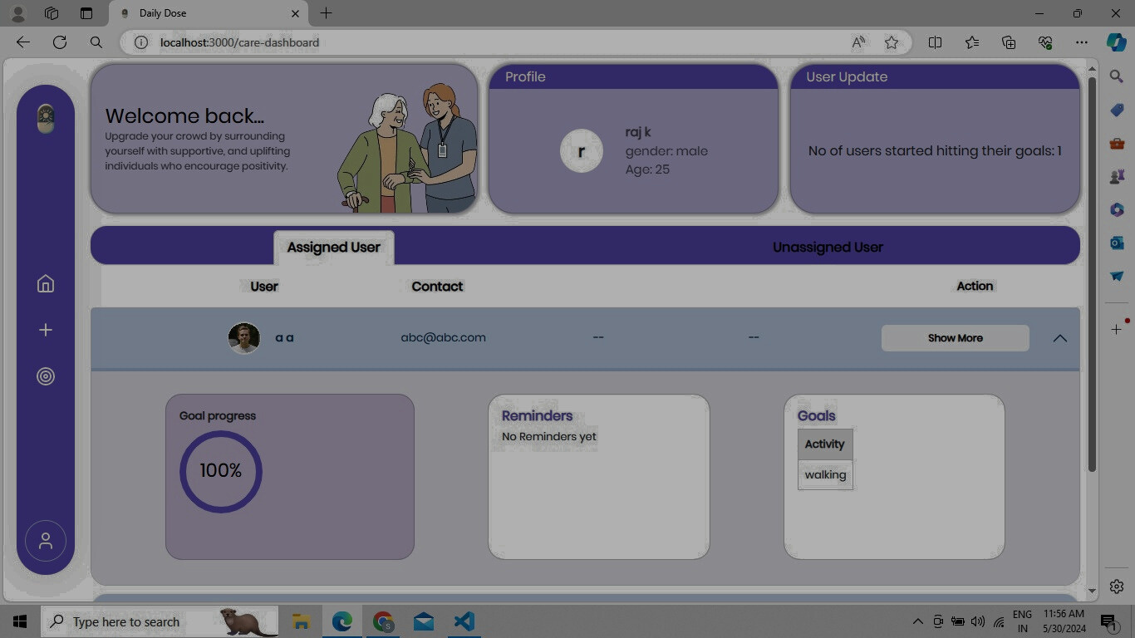
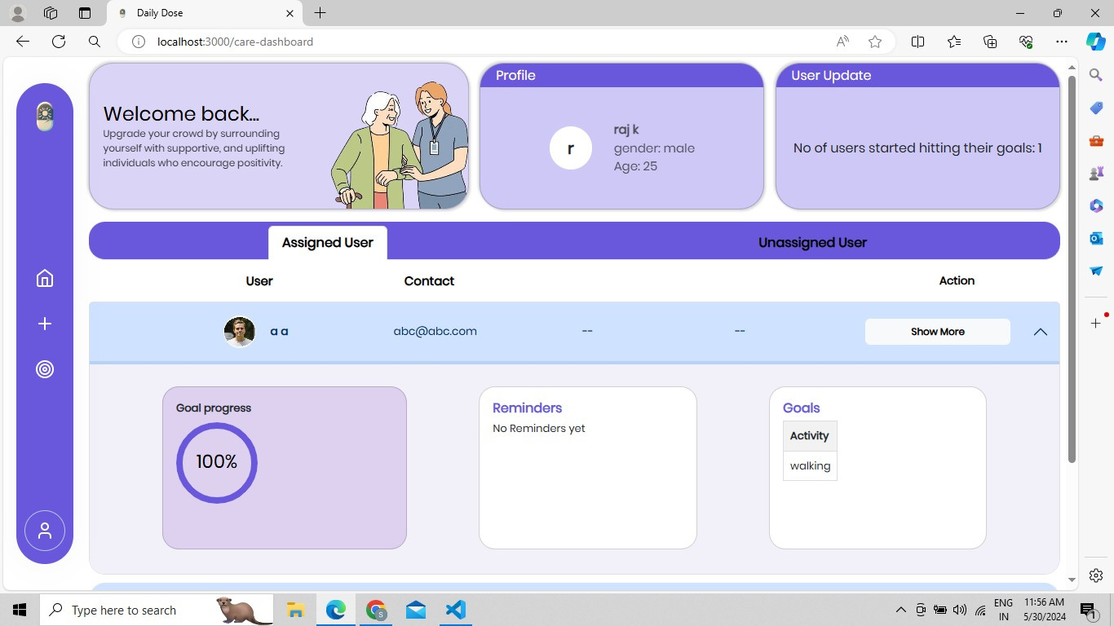
Caretaker Dashboard
Users

Slide 50
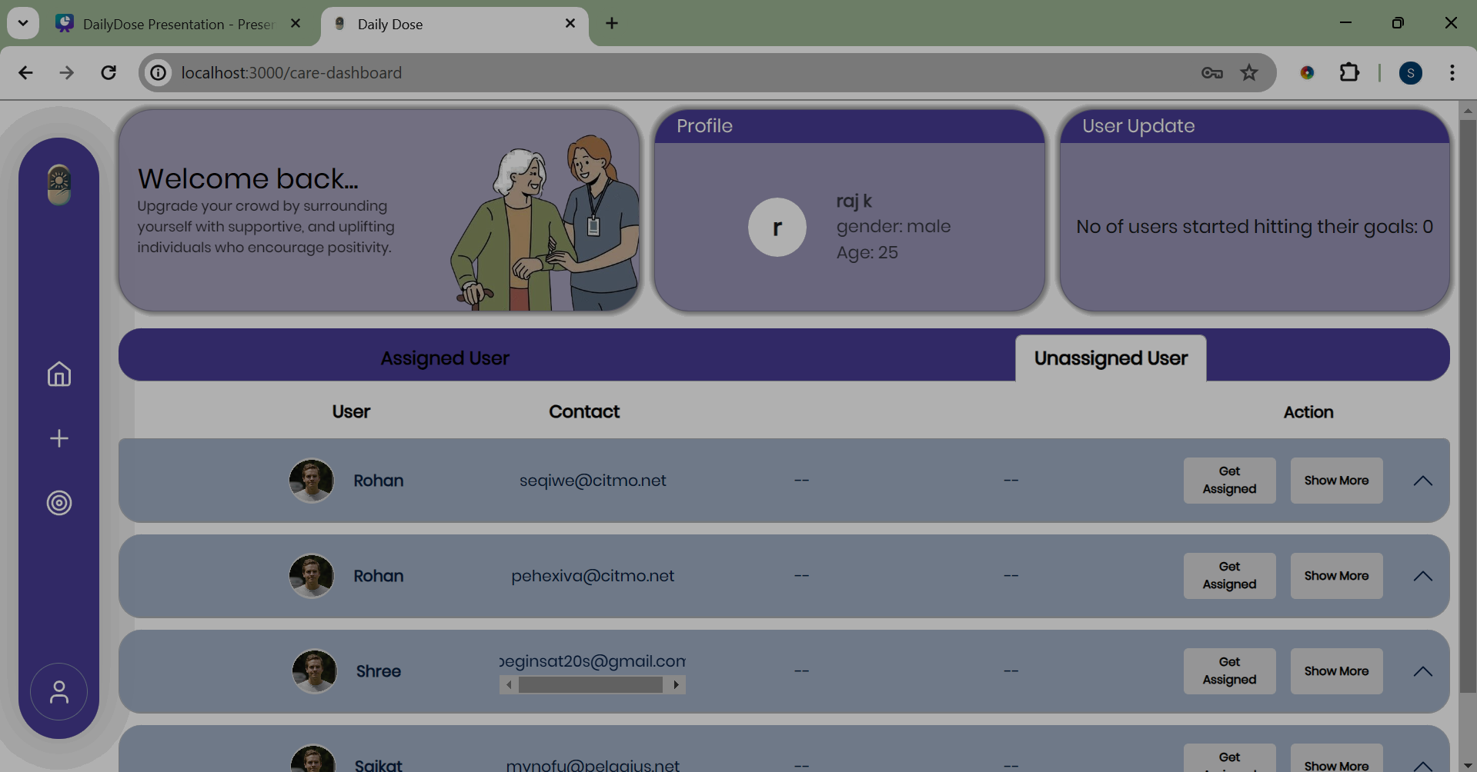
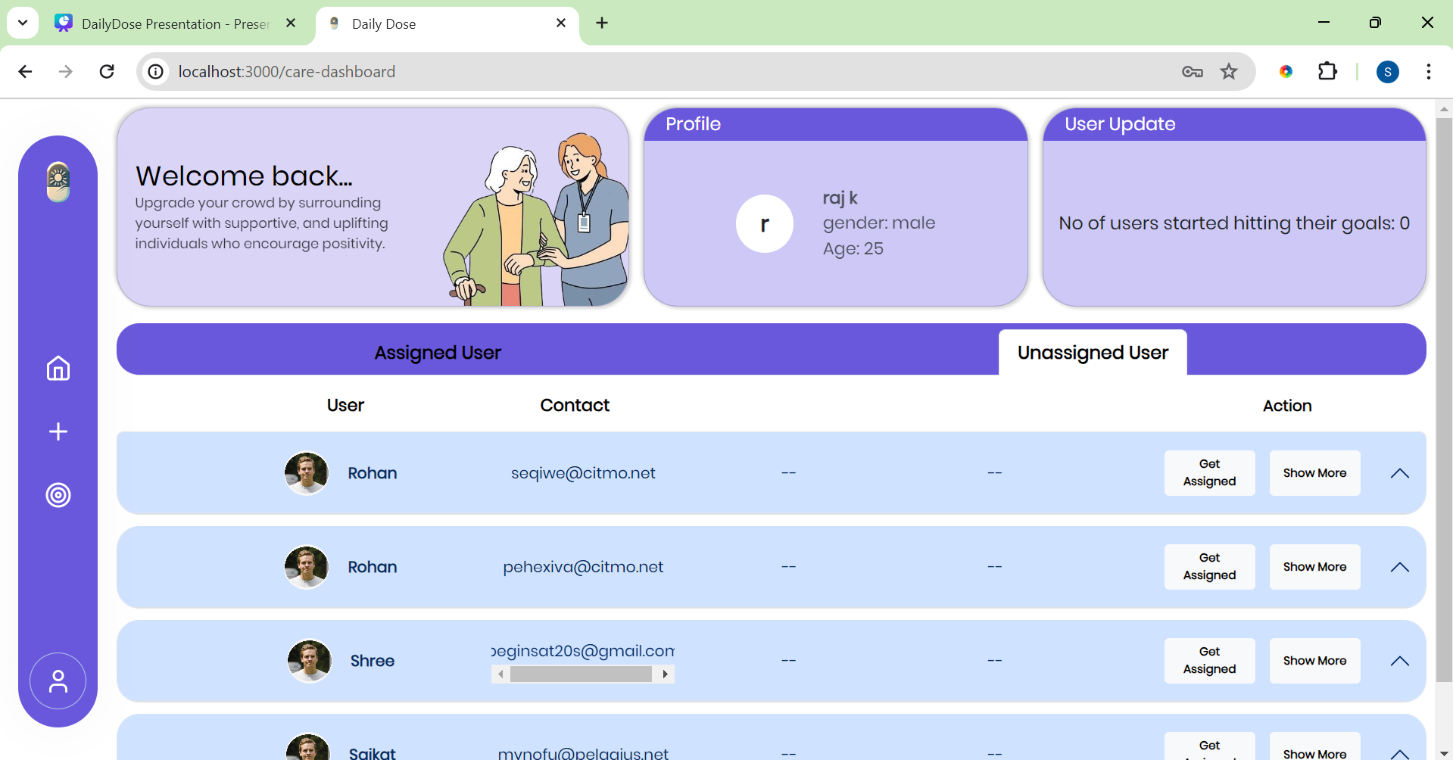
Unassigned Users
Unassigned User

Slide 51
Unassigned Users
Get User Assigned from here

Slide 52
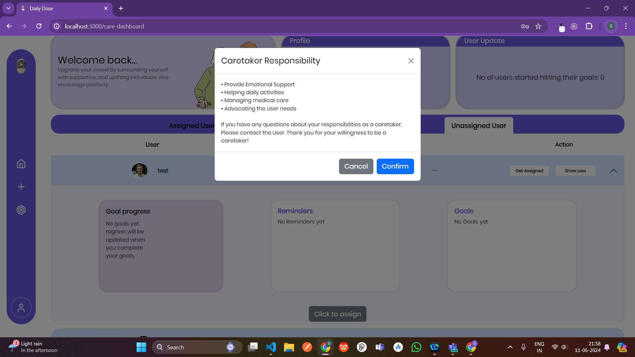
Confirmation to Get the User Assigned and be a Caretaker

Slide 53
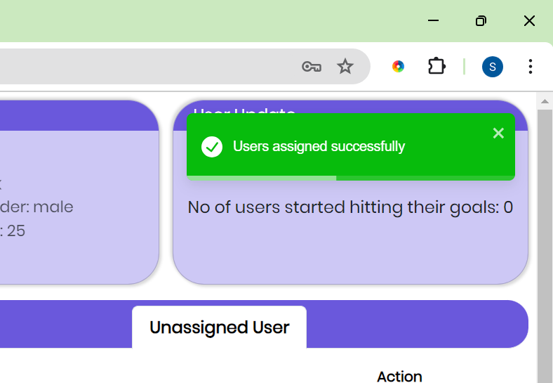
Unassigned Users
User Assigned

Slide 54
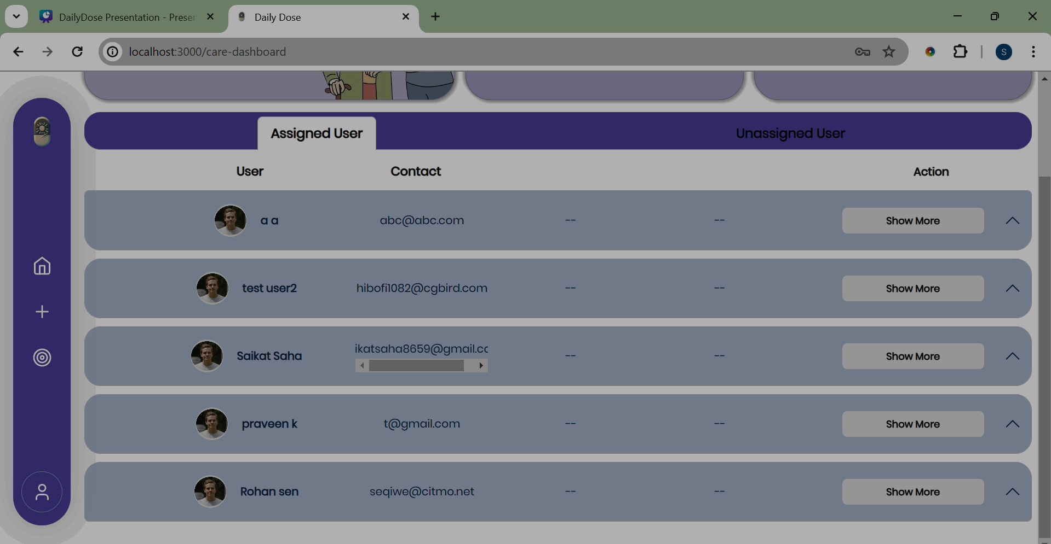
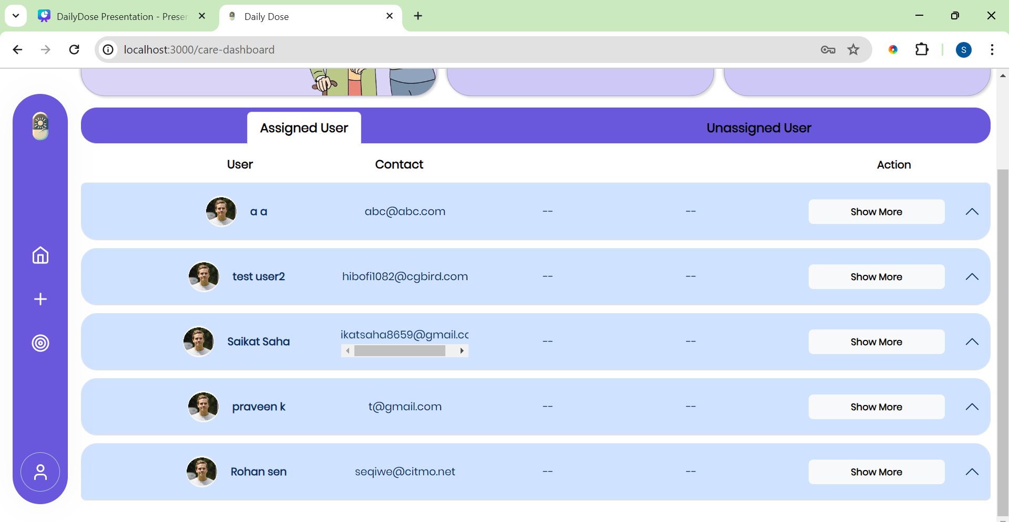
User Got Assigned
This User Got Assigned

Slide 55
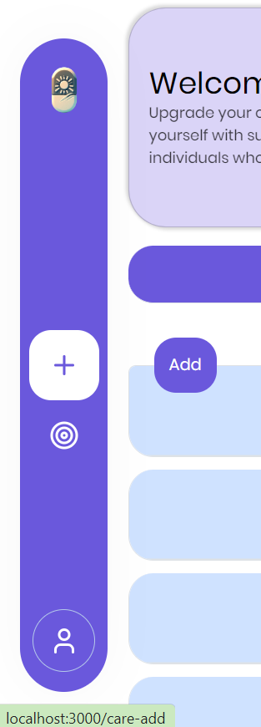
Add Goals for User
Add Goals for User

Slide 56
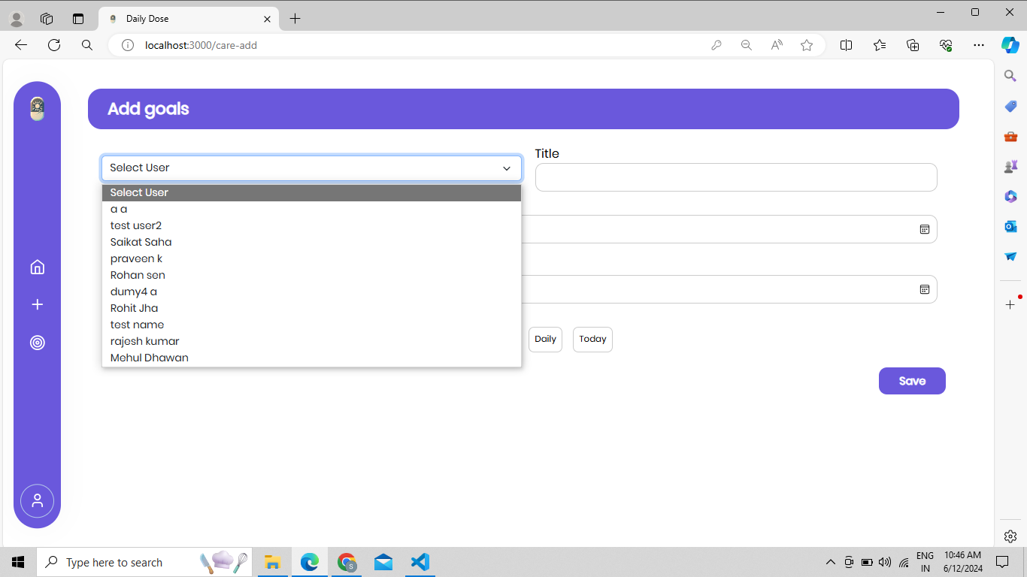
Assign Goals to user
Assign Goals by selecting a User

Slide 57

Assign Goals to user

Slide 58

Caretaker Dashboard
Keep track of Assigned User

Slide 59

Interface to Track Each User Individually

Slide 60

Interface to Track Each User Individually
Click to Track User

Slide 61


Interface to Track Each User Individually

Slide 62

Access Request Failed
Notes:
If a resource you're looking for isn't found, we'll guide you to our friendly 404 page, with a "Go Back" button ensuring you're always on the right path.

Slide 63

Github Repository

Slide 64
CareGiving
se
DailyD
O
Small reminders, Big impact
Notes:
So, this is our dailyDose project.
where Small reminders is trying to make big impact.
We're grateful for the opportunity to present our project

Slide 65

DailyDose
Thank You
For Your Attention in Our Presentation
-Team DailyDose
Notes:
Thankyou

